Slide 1
Learning English
Issue 2

Slide 2


Slide 3
21-24 DBCB 25-28 ABCD
29-31 CAB 32-35 DBCA
36-40 BFDGE 41-45 ABDCD
46-50 ABACD 51-55 CABDC
56-60 BACBD

Slide 4
61 a 62 did
63 healthy 64 best
65 too 66 to go
67 which 68 After
69 sitting 70 what

Slide 5
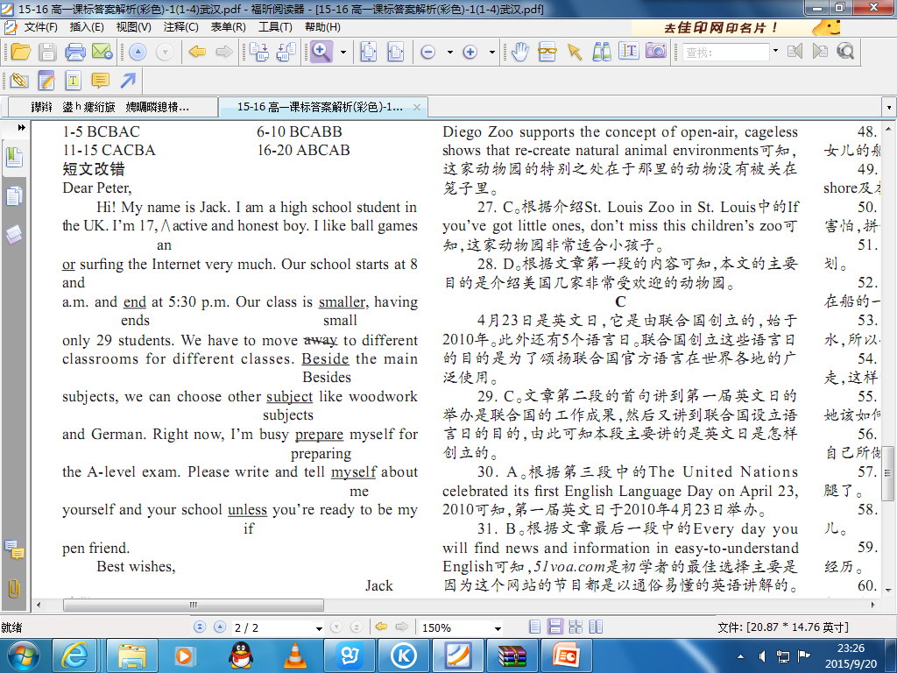

Slide 6
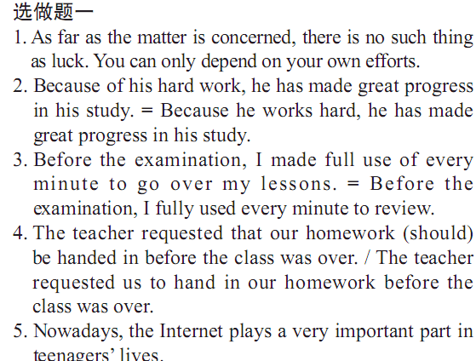

Slide 7
1-5 ＣＤＢＡＢ
６－１０ ＣＡＢＤＤ

